Slide 1


Optimizing enzyme combinations for shotgun proteomics
Sabrina Khuntia
Gao Lab (College of Pharmacy)

Slide 2

Outline
Research question
Physicochemical property comparisons
Enzymatic cleavage simulation (using AlphaFold predicted structures of collagen proteins)
A new mathematical approach calculate digestion rate

Slide 3
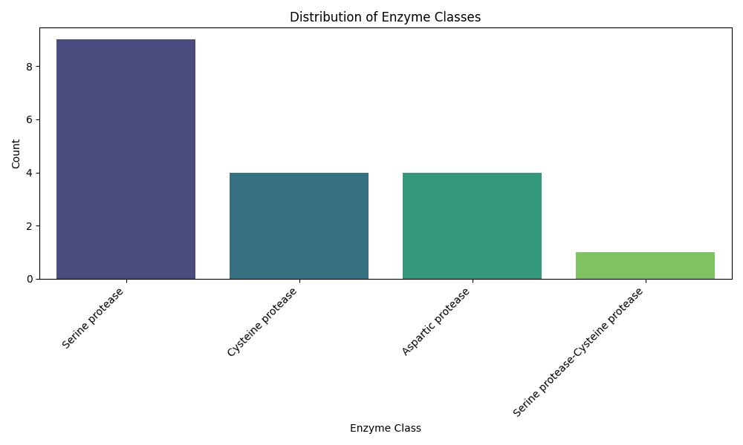
Introduction
Limitations of average proteomic experiments
Ex: coverage of human proteome = 99% with 6 enzymes vs. 86% with trypsin alone
Emphasis on mass spectrometry proteases

Slide 4
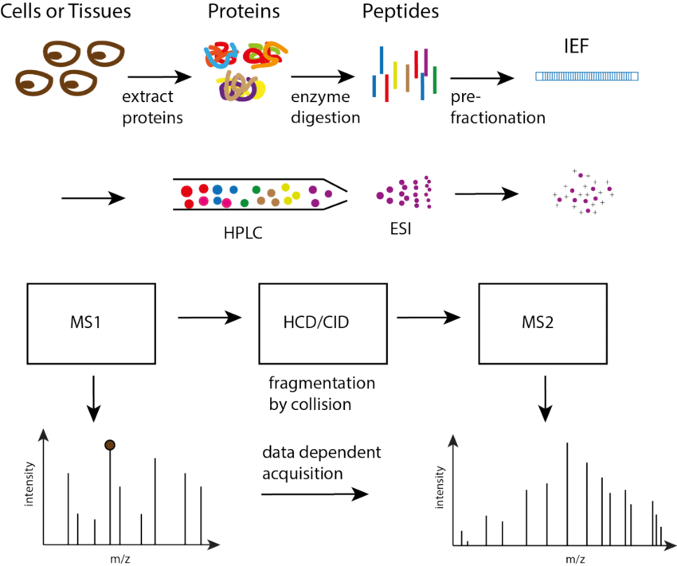
Optimization focus

Slide 5
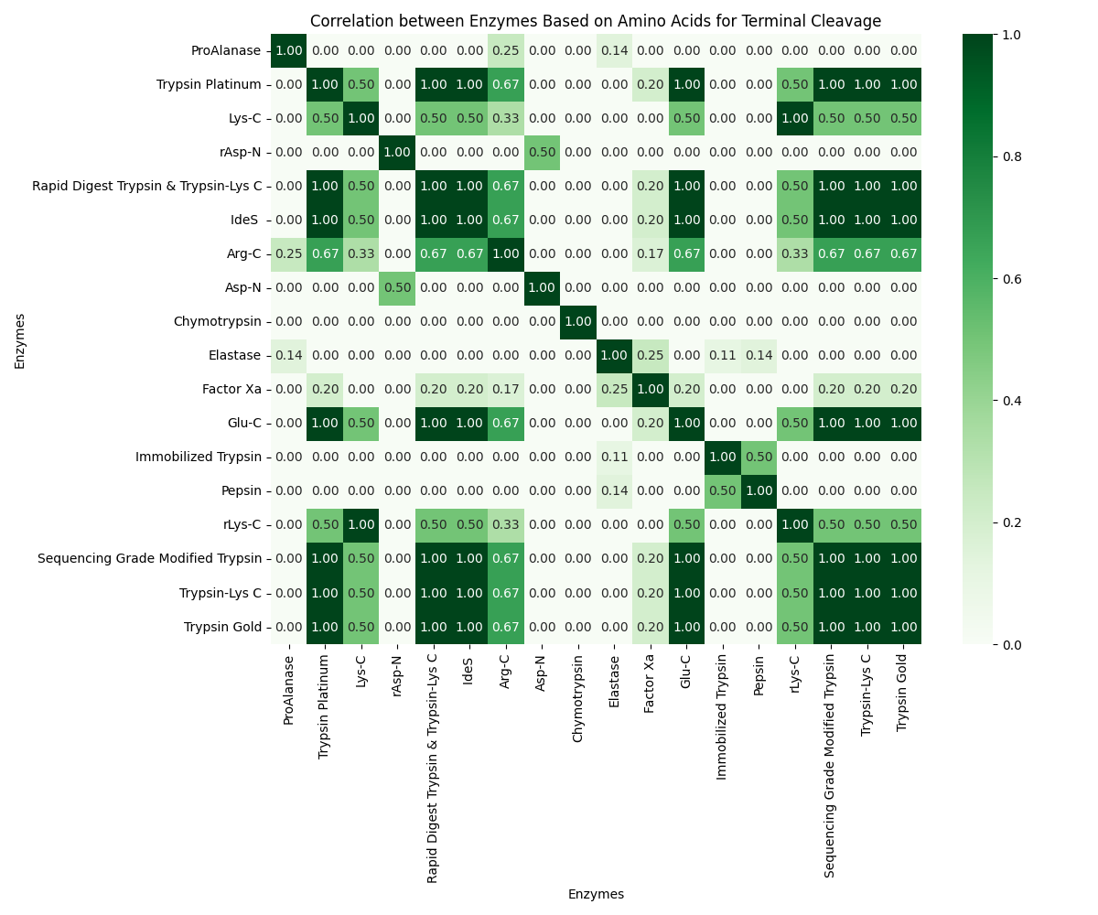
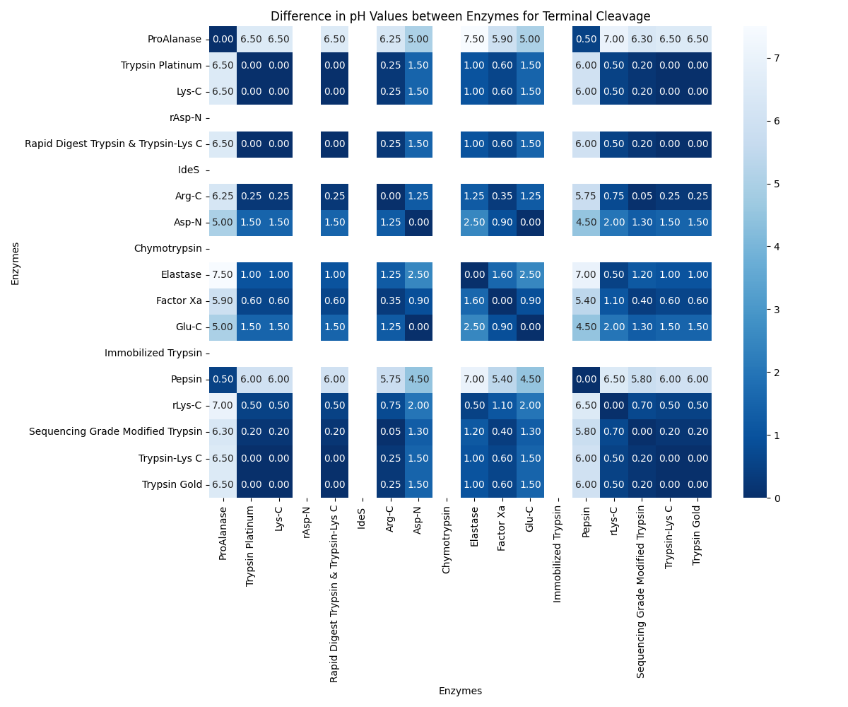
Protease cleavage site/ideal pH specificity maps

Slide 6
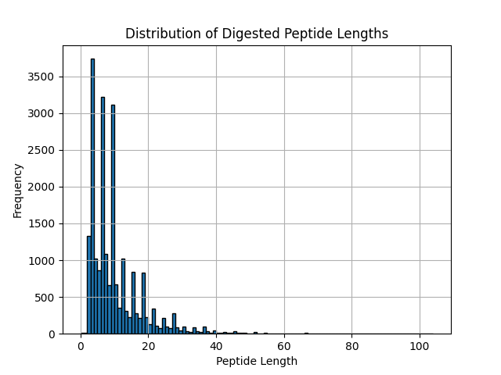
Simulation result of cleaving collagen proteins with trypsin
Number of peptides that satisfy the mass spectrometer's detectability conditions: 11372
Theoretical average detected sequence coverage by trypsin: 42.32%
Average length of digested peptides: 9.734062668827661
Maximum length of undigested peptides: 104

Slide 7
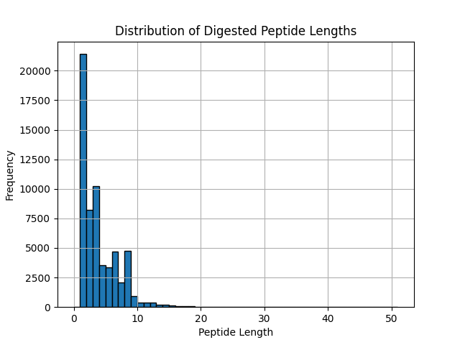
Simulation result of cleaving collagen proteins with chymotrypsin
Number of peptides that satisfy the mass spectrometer's detectability conditions: 9787
Theoretical average detected sequence coverage by chymotrypsin: 38.42%
Average length of digested peptides: 3.52816487712542
Maximum length of undigested peptides: 51

Slide 8
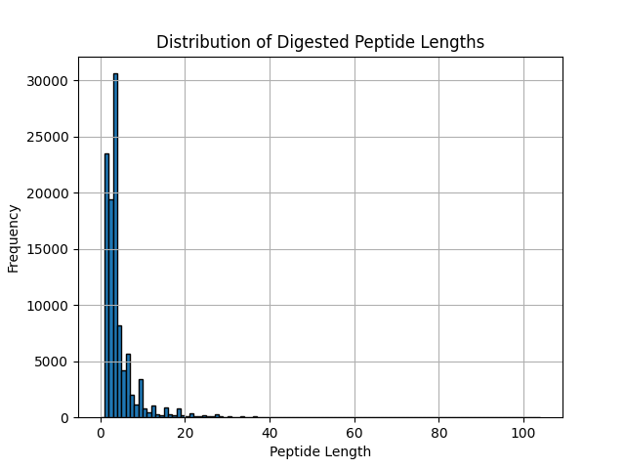
Simulation result of cleaving collagen proteins with trypsin + chymotrypsin (sequential)
Number of peptides that satisfy the mass spectrometer's detectability conditions: 13300
Theoretical average detected sequence coverage by trypsin and chymotrypsin: 49.56824982771619%
Average length of digested peptides: 4.094245299096745
Maximum length of undigested peptides: 104

Slide 9
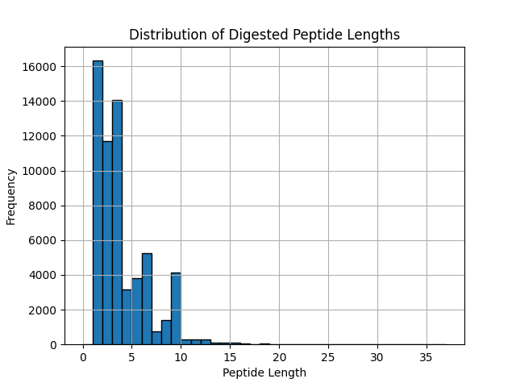
Simulation result of cleaving collagen proteins with elastase
Number of peptides that satisfy the mass spectrometer's detectability conditions: 7635
Theoretical average detected sequence coverage by elastase: 31.62%
Average size of digested peptides: 3.4868003031817962
Maximum size of undigested peptides: 37

Slide 10
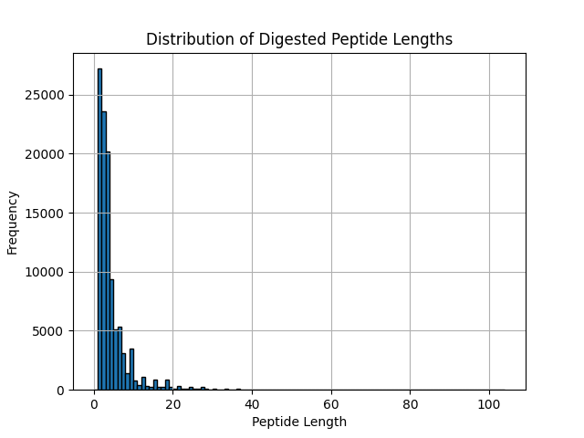
Simulation result of cleaving collagen proteins with trypsin + elastase (sequential)
Number of peptides that satisfy the mass spectrometer's detectability conditions: 14911
Theoretical average detected sequence coverage by trypsin and elastase: 55.148395332380574
Average size of digested peptides: 4.066256053411068
Maximum size of undigested peptides: 104

Slide 11
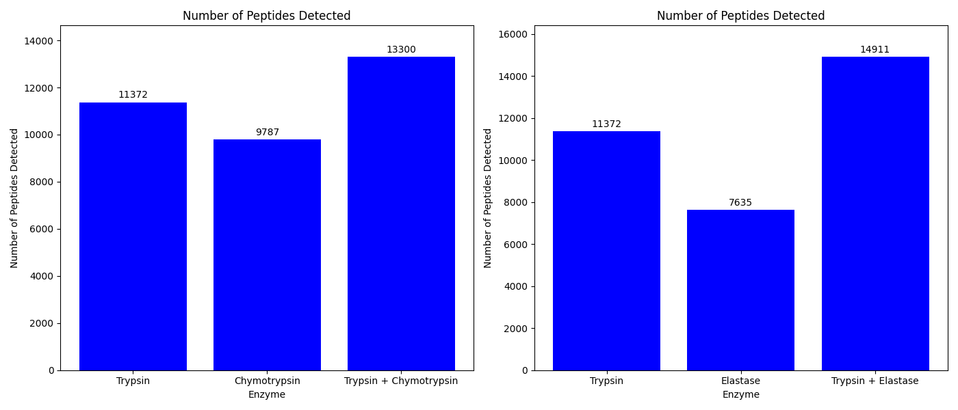
Comparison of detectable peptides (per enzymes vs. multi-enzyme)

Slide 12
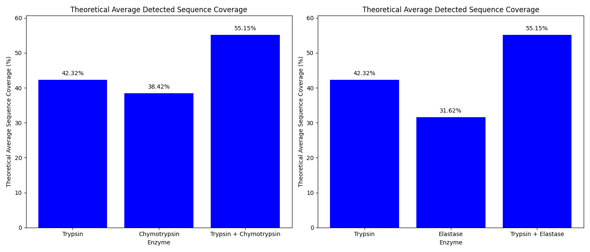
Comparison of theoretical detected coverage (by enzymes vs. multi-enzyme)

Slide 13
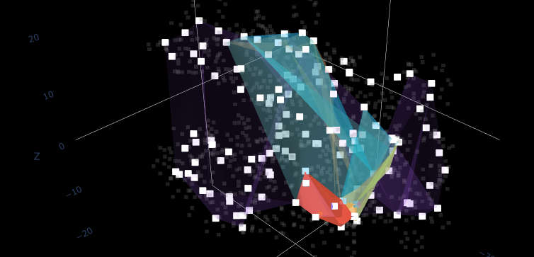
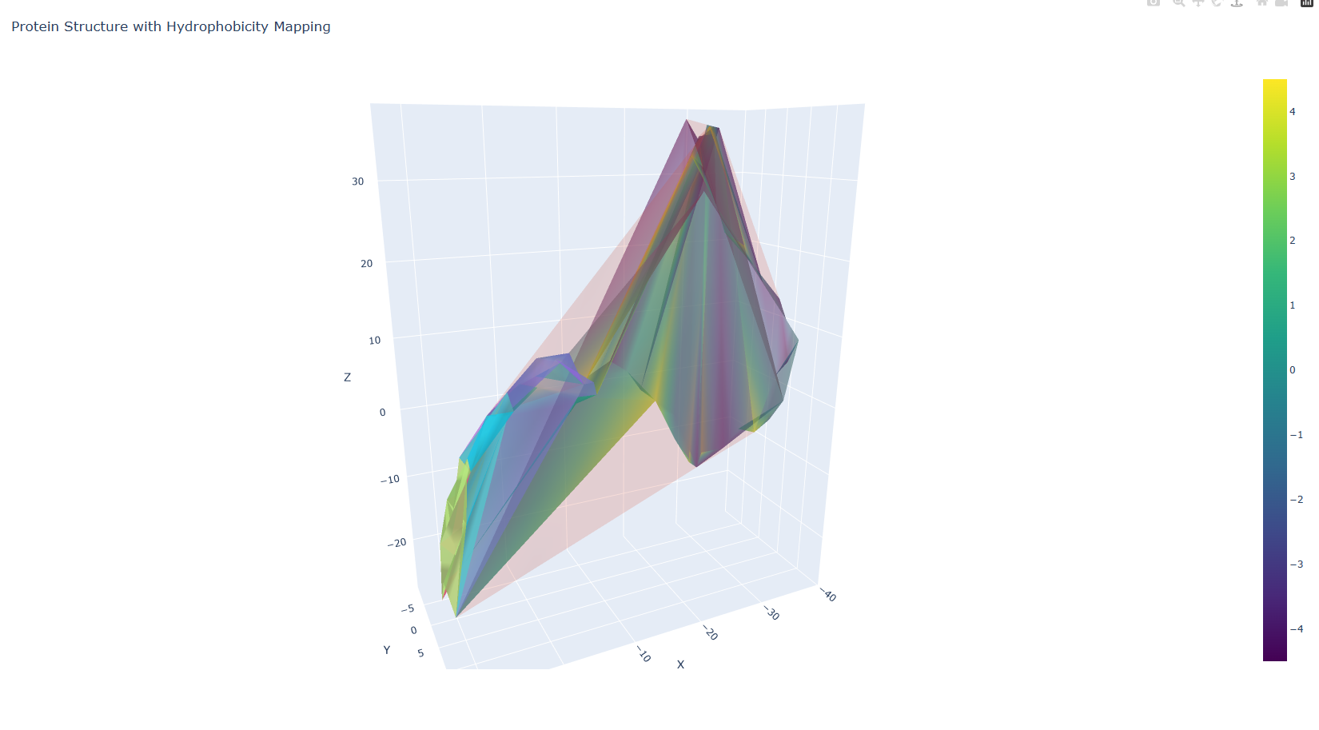
Hull layer parameter
Convex hull peeling method
Imposes layers on backbone atomic coordinates
Allows for a better idea of directional affinity relative to the centroid
Gauges when the substrate breaks apart

Slide 14
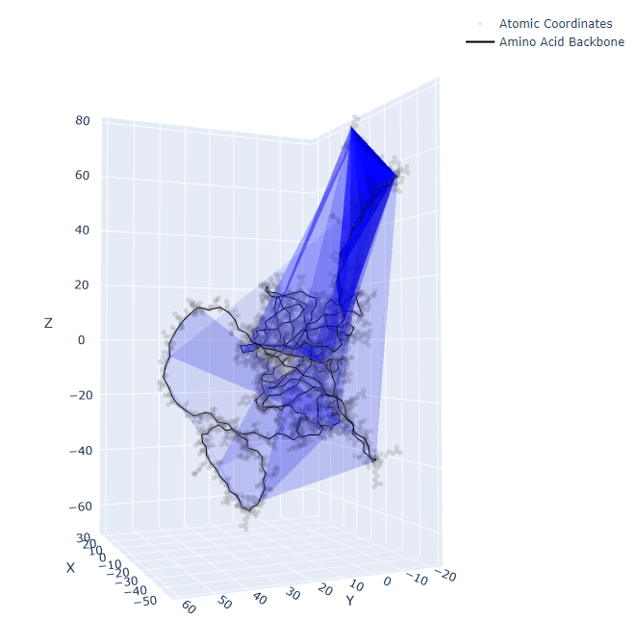
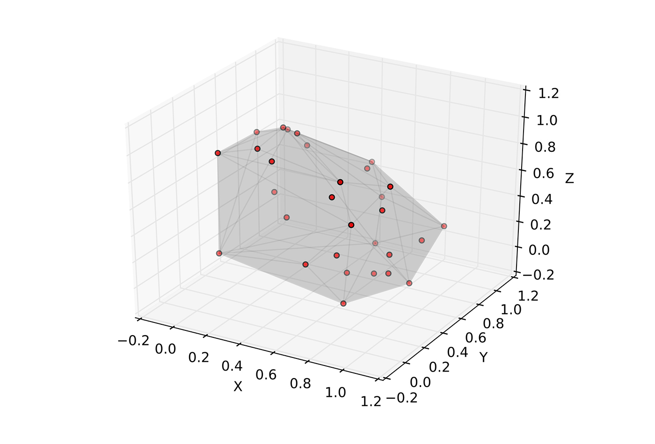
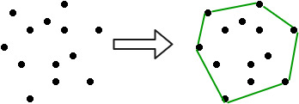
Structurizing molecular models with convex hulls
3D (PROTEIN)
3D (GENERAL)
convex hull = smallest convex shape that contains the given set of points
1) Find a three-dimensional convex hull by determining the following:
The largest polyhedron whose vertices are points in B.
The set of all convex combinations of points in B.
The intersection of all convex regions in B.
The union of all simplices with vertices in B.
To continue layering, ideally until the minimum hull length is reached (for biomolecules, set this value as the length of the smallest building block in the structure):
2) “Delete” vertices.
3) Repeat steps 1-3 (in other words, keep finding a new hull based on the previous hull).
2D

Slide 15
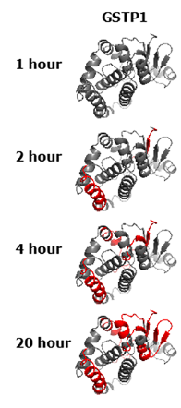
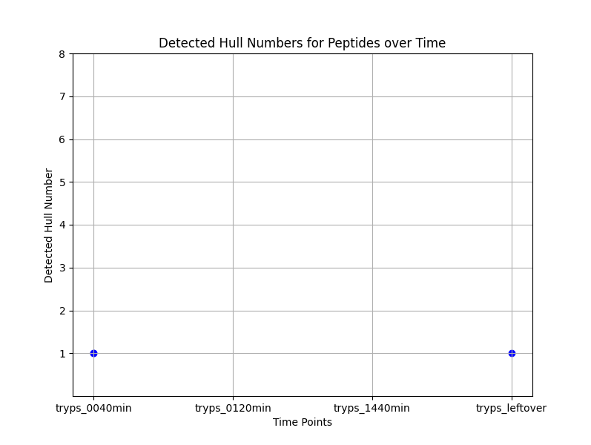
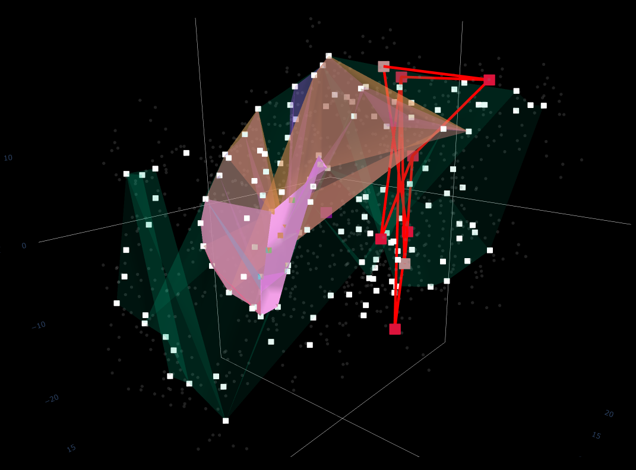
A combined approach to determine the kinetics of enzymatic cleavage
1. Limited Proteolysis
2. Computational Geometry

Slide 16

Thank you!

